Slide 1
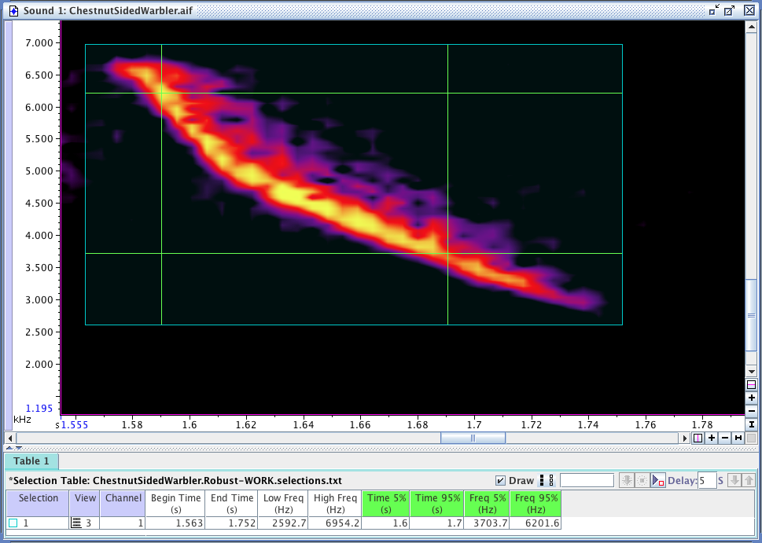
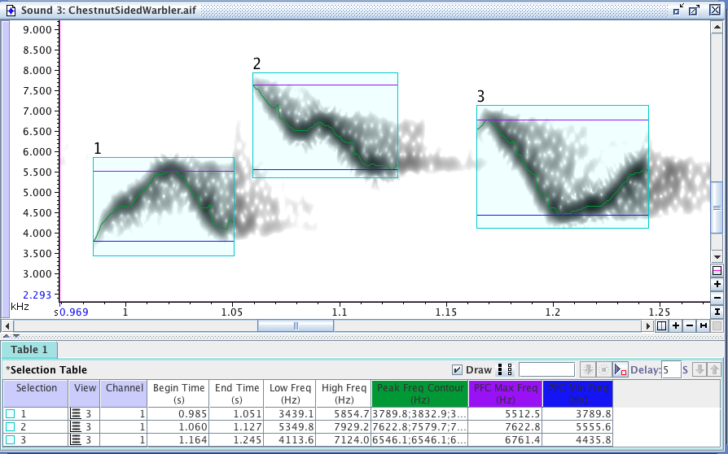

Raven measurements 2
Sound Analysis Workshop
Ithaca, NY
28 March – 1 April 2016
© 2007-16, Cornell Bioacoustics Research Program

Slide 2
Limitations of basic Raven measurements
Variability of manually drawn boxes:
signal-to-noise ratio
distance between animal and mic
reverberation
brightness and contrast settings
human subjectivity
. . .
Basic Raven measurements are based on everything in the selection box

Slide 3
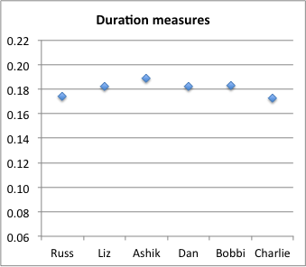
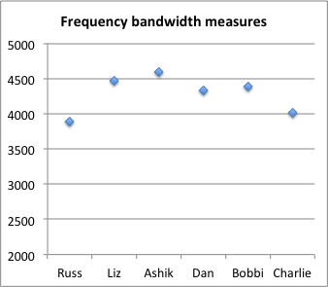
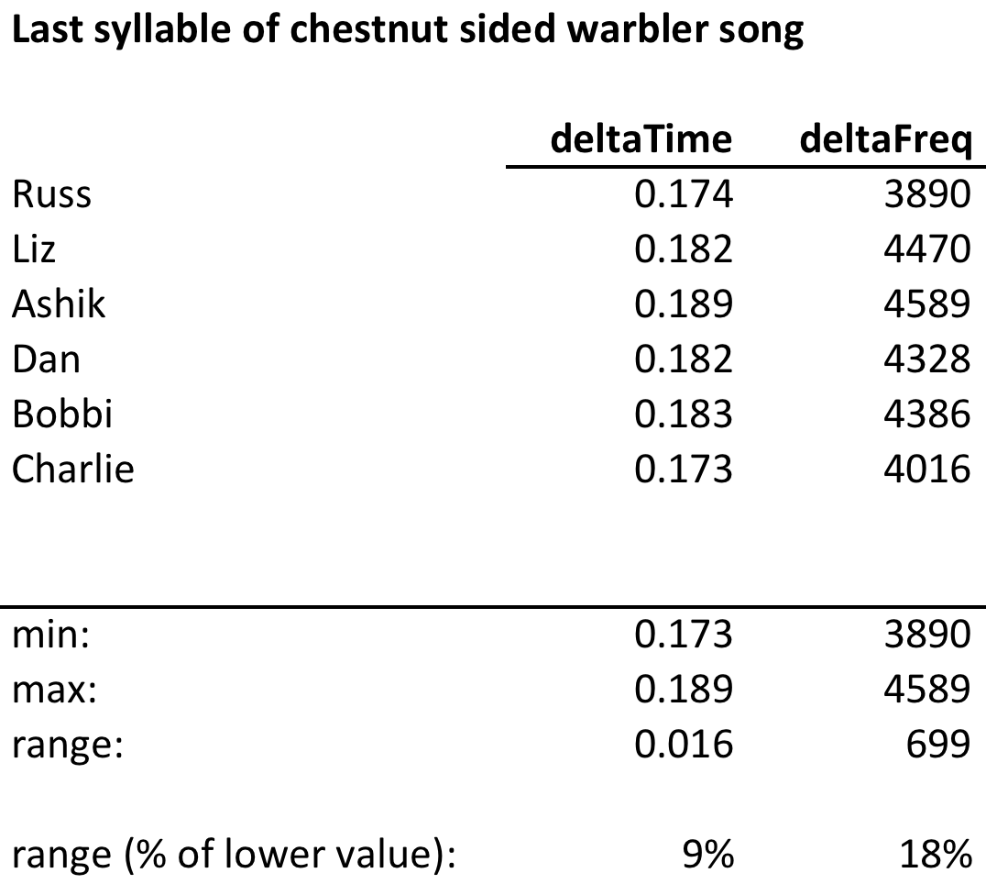
Limitations of basic Raven measurements
Inter-observer variation

Slide 4
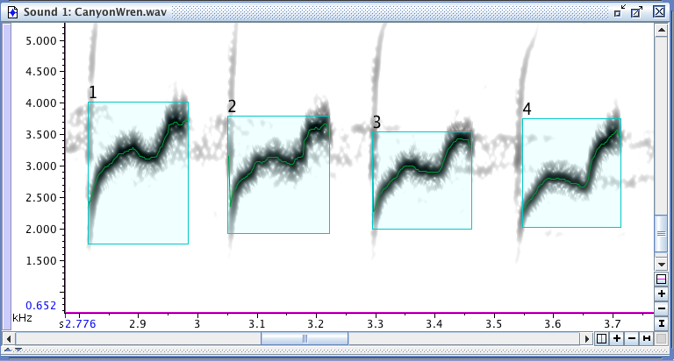
Mitigating measurement limitations
“Robust” measurements
Measurements based on Peak Frequency Contour

Slide 5
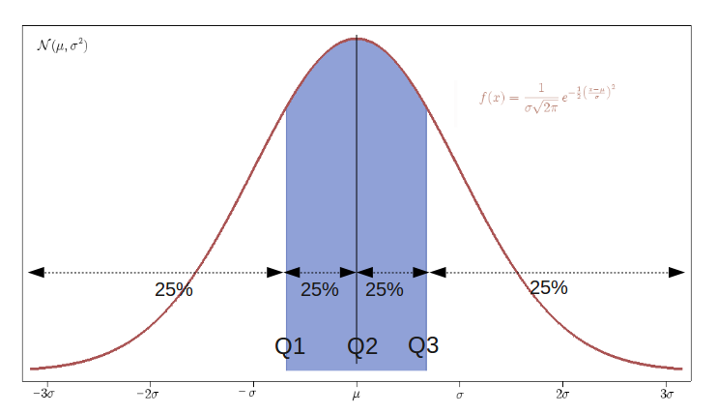
“Robust” measurements of energy distribution
Measurements that are less sensitive to (“robust” against) variation in:
signal-to-noise ratio
distance between animal and mic
reverberation
brightness and contrast settings
human subjectivity
. . .
Based on percentile distributions of energy in time and frequency
http://commons.wikimedia.org

Slide 6
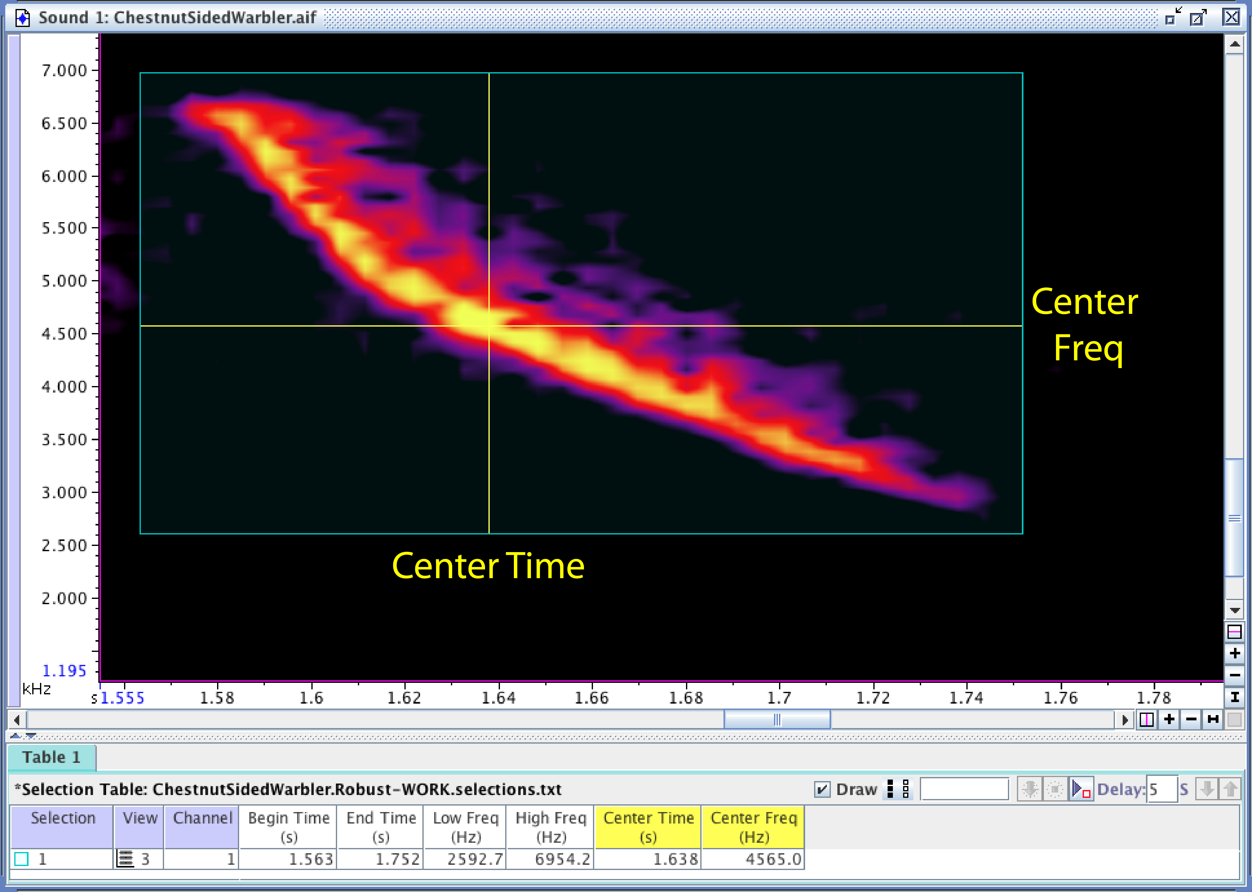
“Robust” measurements of energy distribution
50% energy
50% energy
50% energy
50% energy

Slide 7
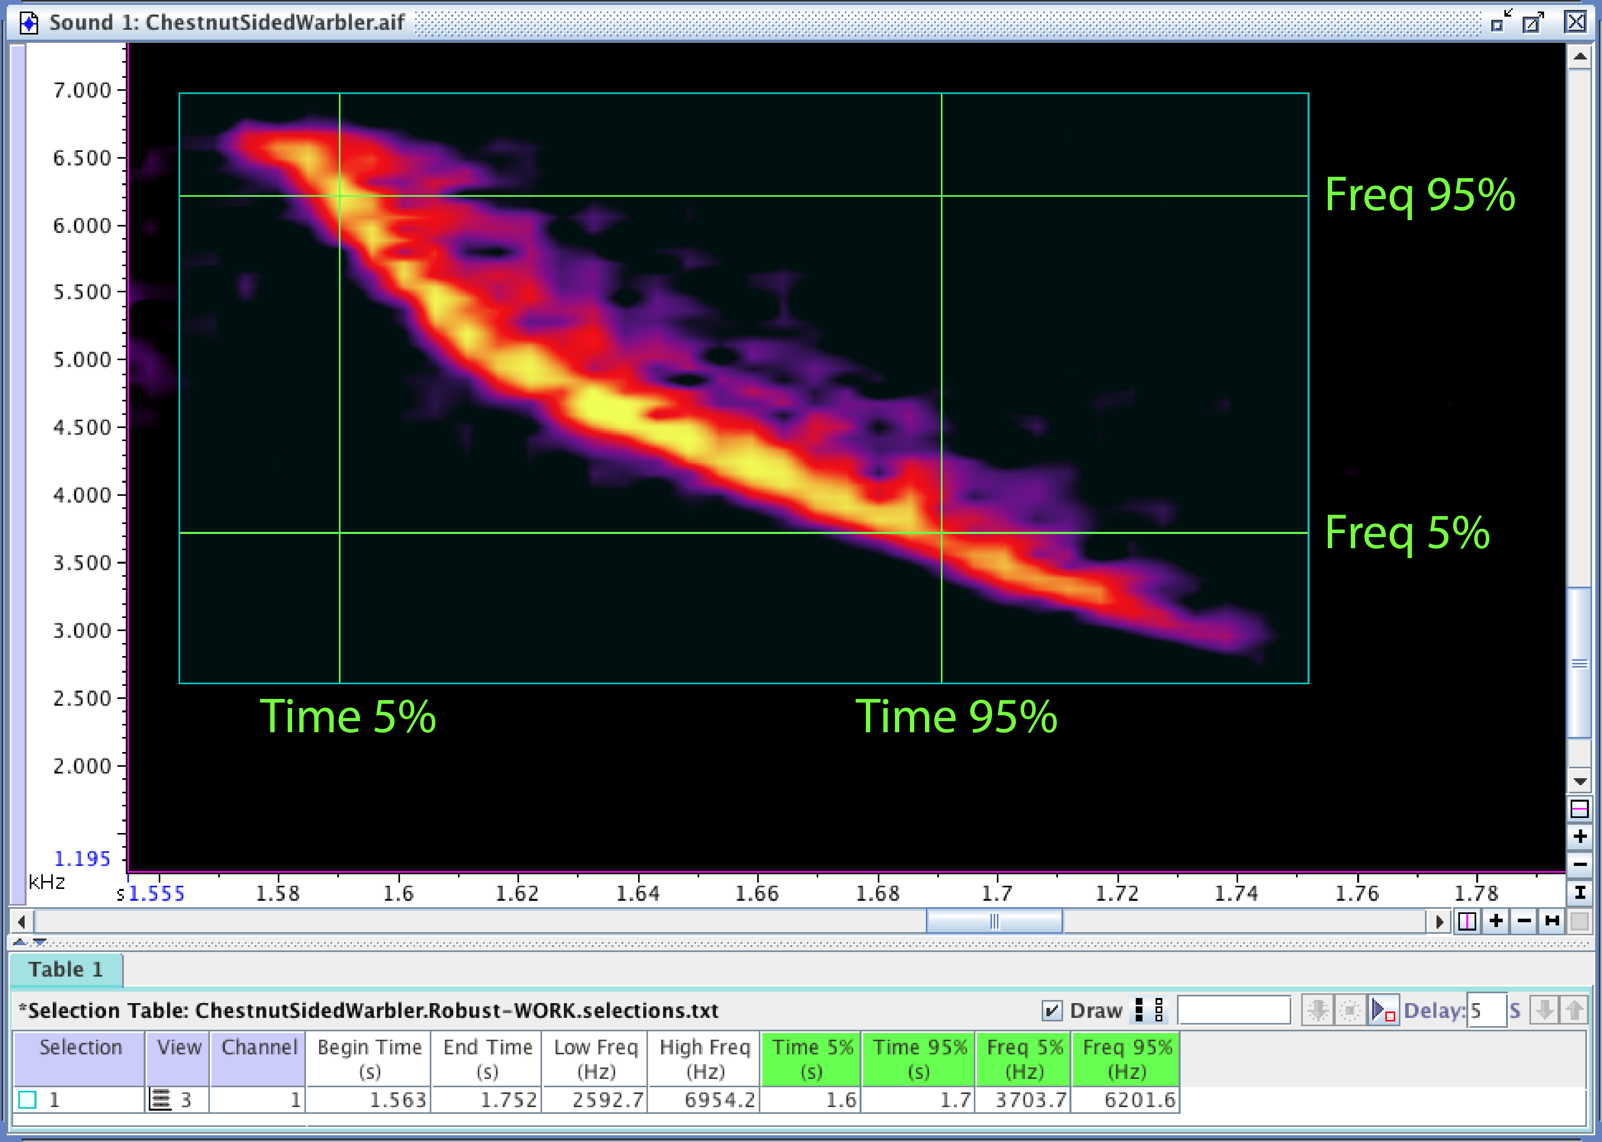
“Robust” measurements of energy distribution
90% Bandwidth
90% Duration

Slide 8
Limitations of basic Raven measurements
Inter-observer variation

Slide 9
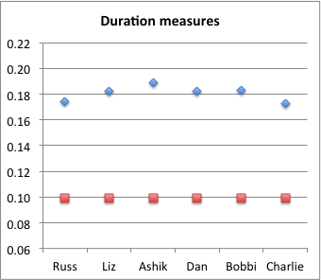
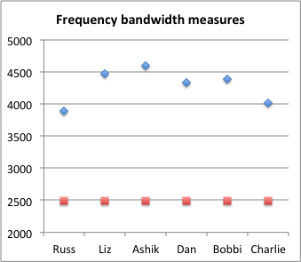
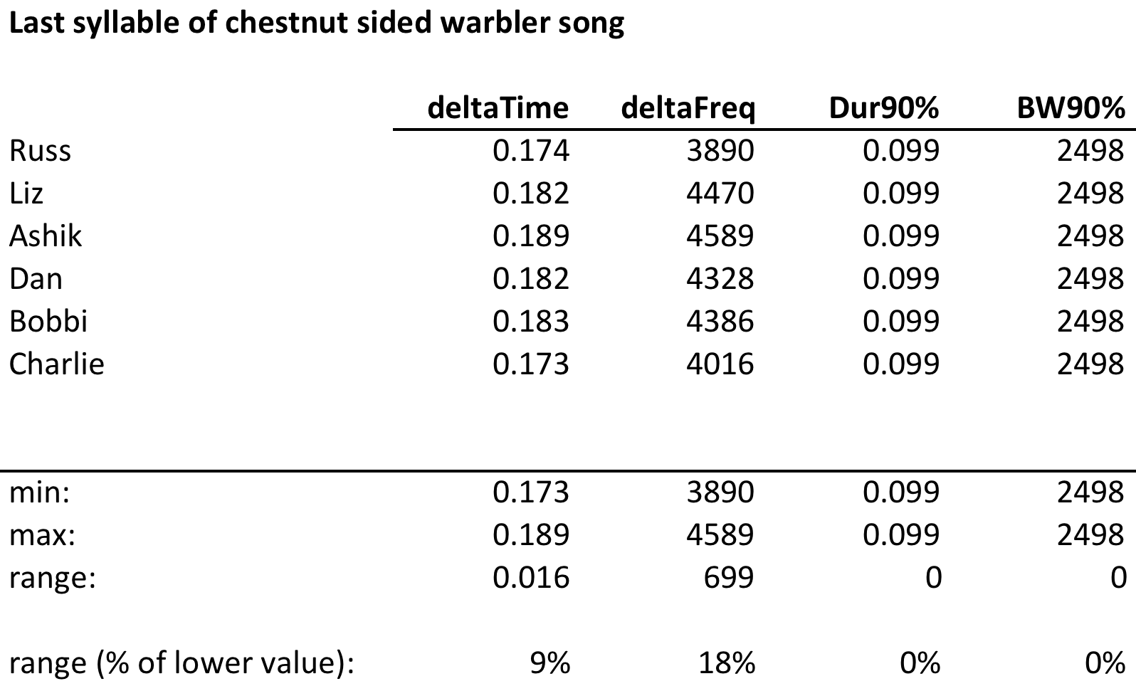
Limitations of basic Raven measurements
Inter-observer variation

Slide 10
Peak Frequency Contour measurements
Measurements based (hopefully) on just the signal
Basic Raven measurements are based on everything in the selection box
but we’re only really interested in some of what’s in the box: the signal
Peak Frequency Contour (PFC) measurements may help
based on peaks in each spectral slice in a selection

Slide 11
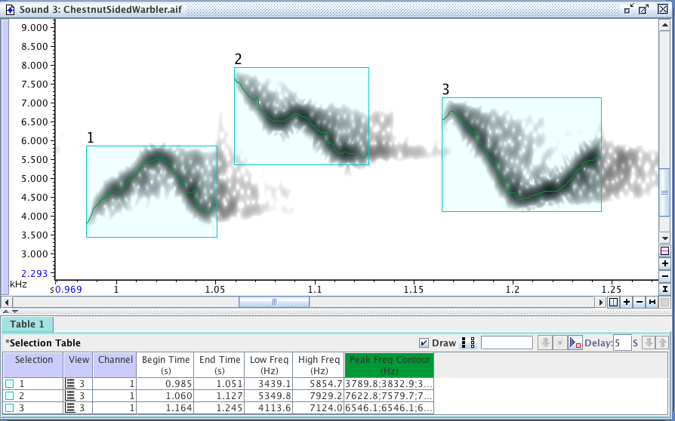
Peak Frequency Contour measurements
Based on peaks in each spectral slice in a selection

Slide 12
Peak Frequency Contour measurements
Based on peaks in each spectral slice in a selection

Slide 13
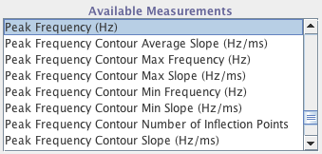
Peak Frequency Contour measurements
Measurements derived from PFC

Slide 14
