Slide 1
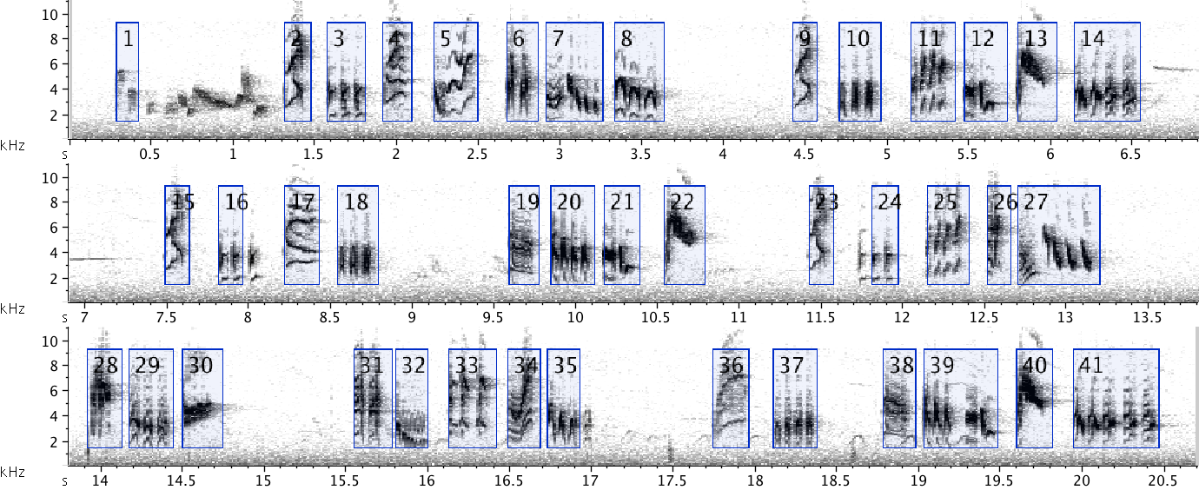
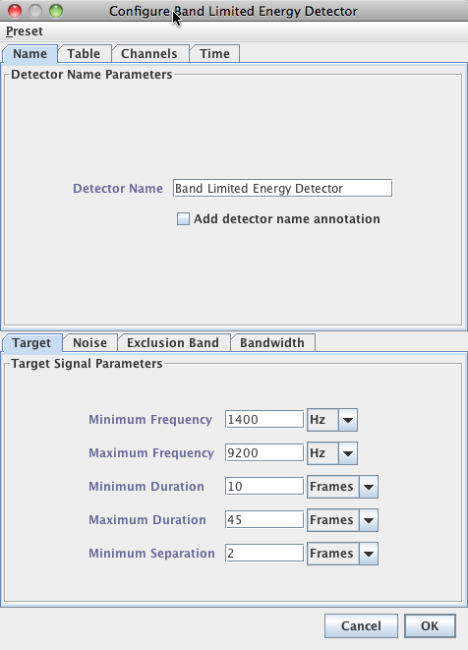

Band-Limited Energy Detector (BLED)
Sound Analysis Workshop
Sierra Nevada Field Campus
San Francisco State University
13 – 15 June 2015
© 2007-15, Cornell Bioacoustics Research Program
Bioacoustics Research Program

Slide 2
Band-Limited Energy Detector (BLED)
What it does
Detects events where the energy in a specified frequency band exceeds a threshold for a specified range of durations.
Gaps where the energy drops below the threshold are ignored unless
they exceed a minimum separation threshold.
The BLED is non-specific: it ignores shape and pattern of the sound.

Slide 3
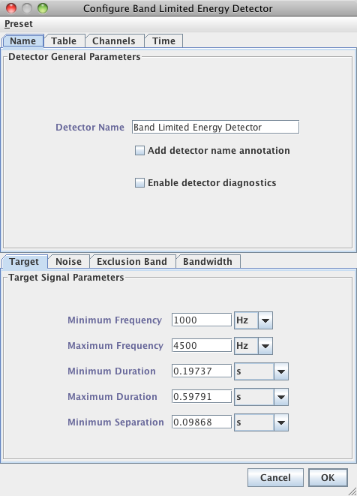
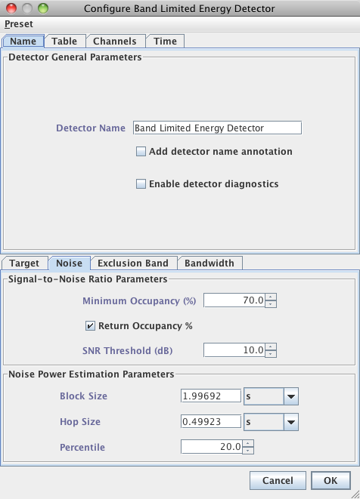
Band-Limited Energy Detector

Slide 4
Band-Limited Energy Detector
How it works
Stage 1. Identify candidate detections, based on signal-to-noise ratio (SNR) in a specified frequency band.
Stage 2. Eliminate candidates that are too short, too long, or
too sparse.
Notes:
RESTRUCTURE:
STAGE 1: Identify candidate detections (by identifying gaps)
STAGE 2: Screen candidates by duration and occupancy.

Slide 5
Band-Limited Energy Detector
How it works
Stage 1. Identify candidate detections, based on signal-to-noise ratio (SNR) in a specified frequency band.
a. Calculate the in-band power for each spectral slice (frame).
b. Estimate the in-band background noise based on the distribution
of powers for all frames.
c. Find gaps where the power remains below the specified SNR for
longer than a specified minimum separation time.
d. Consider segments between gaps as candidate detections.
Notes:
RESTRUCTURE:
STAGE 1: Identify candidate detections (by identifying gaps)
STAGE 2: Screen candidates by duration and occupancy.

Slide 6
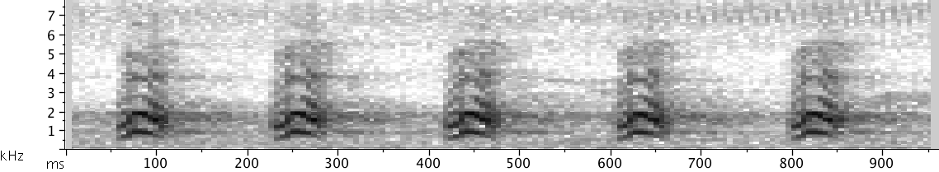
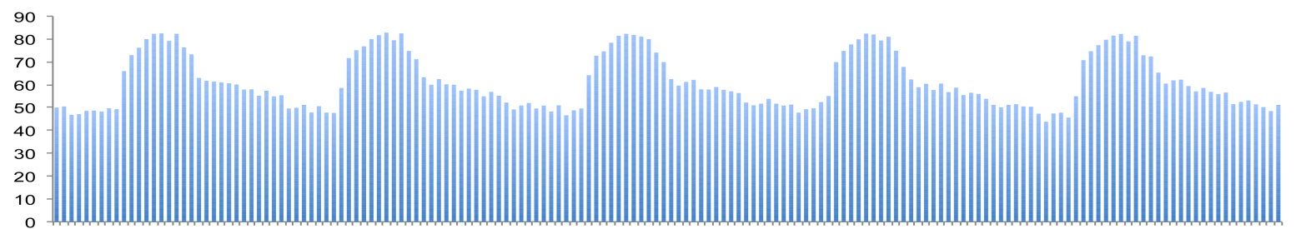
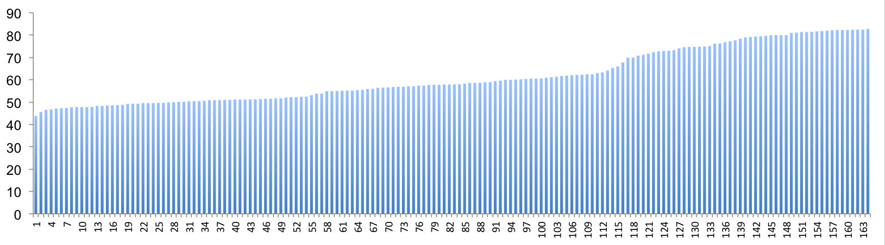
Band-Limited Energy Detector
Stage 1: Identify candidate detections
1. Calculate in-band power for each spectral slice (or “frame”):
In-band power (dB)
Time →
2. Estimate background noise:
a. sort the power values
b. choose a low percentile power value for the noise estimate
20%
In-band power (dB)
Power order →

Slide 7
Band-Limited Energy Detector
Stage 1: Identify candidate detections
3. Apply noise estimate + threshold to sequence of power measurements:
4. Identify gaps longer than Minimum Separation where power is < threshold:
gap
+10 dB SNR threshold
In-band power (dB)
20% noise estimate
Time →

Slide 8
Band-Limited Energy Detector
Stage 1: Identify candidate detections
5. Consider segments between gaps to be candidate detections:
gap
In-band power (dB)
Time →

Slide 9
Band-Limited Energy Detector
Stage 2: Eliminate candidate detections
5. Consider segments between gaps to be candidate detections:
In-band power (dB)
Time →
Eliminate candidates that are too short, too long, or too sparse;
declare remaining candidates to be detections:

Slide 10
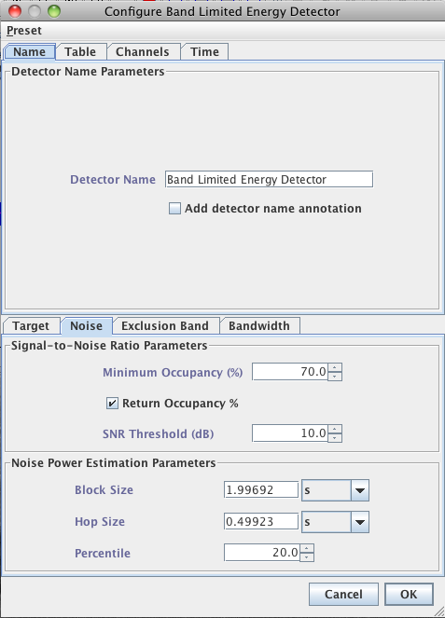
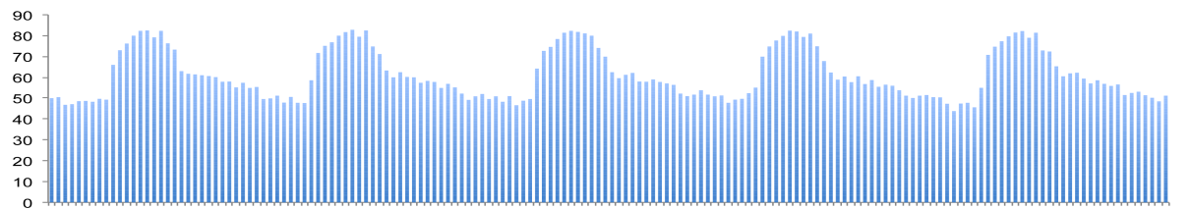
Band-Limited Energy Detector
What do we mean by too sparse?
Occupancy: The percentage of individual power values in a candidate detection that are above the SNR threshold.
In-band power (dB)
Time →
A candidate detection is too sparse if its occupancy is below the specified Minimum Occupancy.

Slide 11
Band-Limited Energy Detector
How it works (recap)
Stage 1: Identify candidate detections
1.1. Compute in-band power for each frame (spectral slice).
1.2. Estimate the background noise by using a low percentile of all of
the in-band power values.
1.3. Determine the SNR threshold (add specified dB value to noise estimate).
1.4. Identify gaps longer than the minimum separation parameter where the power remains < SNR threshold.
1.5. Consider sequences of frames between gaps as candidate detections.
Stage 2: Prune candidates
2.1. Eliminate candidate detections that are too short, too long, or too sparse.
2.2. Declare the remaining candidates as detections.

Slide 12
Band-Limited Energy Detector
What you need
1. Lower and upper frequency limits for target.
2. Min and max duration of target.
3. Minimum separation (“gap”) between targets.
The minimum separation needed to recognize that there are two separate events (rather than one with a brief dropout); this is typically much shorter than the minimum separation between events that you observe in the recording.
4. Approximate signal-to-noise ratio.

Slide 13
Band-Limited Energy Detector

